Slide 1
Health Equity
IN SCHOOLS
Trainer Name
Date
Notes:
WELCOME
STATE: Good morning. My name is _____ and I want to welcome you to the Health Equity in Schools module.
Today we will be talking about health equity and what it means for students in our schools. This is an important concept in school health since we know healthy students are better learners.

Slide 2
On Our Agenda . . .
Assess your current knowledge
Explore examples of health disparities, health equity, and health equality
Use an “equity lens” to generate real-life examples
Notes:
AGENDA
STATE: During this module, we will begin to explore the impact of health equity and health inequity in schools. Today, we will:
Assess your current knowledge
Explore examples of health disparities, health equity, and health equality
Use an “equity lens” to generate real-life examples
Brainstorm actions to support health equity in your school and community

Slide 3
Objectives
Define health disparities, health equity and health equality
Provide examples of health disparities, health equity and health equality
Explain why addressing health equity is important for education
Notes:
OBJECTIVES
STATE: As result of this training, you will be able to:
1. Define health disparities, health equity, and health equality
2. Provide examples of health disparities, health equity, and health equality.
3. Explain why addressing health equity is important for education

Slide 4
Materials
Handout Packet
#1: What Do You Know?
#2: Key Points and Notes
#3: Using a Health Equity Lens
#4: Closing and Optional Activity
#5: Additional Resources
Notes:
MATERIALS
STATE: In front of you, you should have the Handout Packet that we will be using today.
Handout #1: What Do You Know?
Handout #2: Key Points and Notes
Handout #3: Using a Health Equity Lens
Handout #4: Closing and Optional Activity
Handout #5: Additional Resources

Slide 5
WARM-UP ACTIVITY:
Complete Handout #1: What Do You Know?
Be ready to share with a partner.
Notes:
WARM-UP ACTIVITY
STATE: Turn to Handout #1: What Do You Know? We are going to do a quick activity to see what you already know about our topic today. I will give you a few minutes to complete this on your own.
Note: If you have more than an hour, you can use a human continuum by posting “true” on one side of the room and “false” on another. People will stand closest to the sign that represents their answer. You can expect the human continuum with processing after each question to last 20–25 minutes.
NOTE: Monitor progress. If less time is needed, proceed.
STATE: Now turn and talk with a partner about your answers. Discuss your answers and the thinking behind them. Feel free to change or rethink your answers as a result of the discussions.

Slide 6
Statement 1
Children of poverty and children from affluence have the same percentage of infectious diseases, injuries, and social-emotional and behavioral problems.
Notes:
REVIEW OF ANSWERS
STATE: Now, let’s take a few minutes to review the answers. Statement 1 says, “Children of poverty and children from affluence have the same percentage of infectious diseases, injuries, and social/emotional and behavioral problems.” Stand if you think this statement is true and stay seated if you think it is false.
NOTE: To integrate physical activity, you can have participants march in place if they think the response is true, or jog in place if they think it’s false.
STATE: This is false. There is a direct correlation between poor health outcomes and poverty. According to the Robert Wood Johnson Foundation’s Commission to Build a Healthier America Report, children living in poverty are seven times more likely to have poor health compared with children living in high-income households.
So, children of poverty have more chronic and infectious disease, injury, and social/emotional and behavioral problems than their more affluent peers.
NOTE: If a majority of the people got it wrong, ask questions to examine their thinking. For example, “Could someone volunteer to share his/her thinking?”

Slide 7
Statement 2
Schools that screen all students for vision, hearing, dental and scoliosis are engaging in equitable health practices.
Notes:
STATE: Our second statement is, “Schools that screen all students for vision, hearing, dental, and scoliosis are engaging in equitable health practices.”
Stand if you think this statement is true and stay seated if you think it is false.
STATE: This is true and an example of health equality where everyone is treated the same, but it may or may not result in equitable outcomes.
ASK: How might this example not result in equitable outcomes?
DO: Allow for a few responses looking for a response similar to below.
In this example, all families receive screening information, but their ability to address their child’s health needs may differ. For example, what happens for the child whose family can’t afford glasses? That is something for us, as a community that cares about kids, to think about. Because while it is an equitable practice, it does not necessarily produce the same outcome for all students.

Slide 8
Statement 3
Continuously striving to reduce barriers to achievement (such as lack of access to health care, inequitable health resources, chronic absenteeism, and engagement in high-risk health behaviors) are examples of striving for health equity.
Notes:
STATE: Let’s look at Statement 3. “Continuously striving to reduce barriers to achievement (such as lack of access to health care, inequitable health resources, chronic absenteeism, and engagement in high-risk health behaviors) are examples of striving for health equity.”
Stand if you think this statement is true and stay seated if you think it is false.
STATE: Yes, this is true. Health equity is about fairness and making sure all students have a fair and just opportunity to be healthy. And research shows healthy students are better learners.

Slide 9
Statement 4
The primary purpose of school is to improve academic outcomes. Due to the demands of teaching and learning, schools should not focus their efforts on improving the physical and mental health of students.
Notes:
STATE: Let’s look at Statement 4. “The primary purpose of school is to improve academic outcomes. Due to the demands of teaching and learning, schools should not focus their efforts on improving the physical and mental health of students.”
I am not going to ask you to share your response to this one because this statement is not true or false. Each of us has an opinion on this, and we are not going to place value judgments on what you select. However, it is important for us to be able to support our thinking and to examine our own biases and opinions as we learn and experience more in our work with children in schools.
I do want you to consider what the World Health Organization stated in 2017. They stated that “An effective school health program can be one of the most cost-effective investments a nation can make to simultaneously improve education and health.”

Slide 10
Statement 5
Schools providing free breakfasts and lunches to students who qualify for free and reduced-cost lunch is an example of a health equity practice.
Notes:
STATE: Statement 5 reads, “Schools providing free breakfasts and lunches to students who qualify for free and reduced-cost lunch is an example of a health equity practice.”
Stand if you think this statement is true and stay seated if you think it is false.
STATE: This statement is actually both true and false. While it is certainly a step in the right direction, two things must happen for this to be a health equity practice. First, it must be a healthy breakfast and lunch. Second, it must be free to all students. (Universal Breakfast) There are often many students in a school whose families do not complete the forms for the free and reduced-cost lunch, although they would qualify if they did. Having a healthy breakfast and lunch for all students, free of cost, more closely aligns with a vision of health equity.

Slide 11
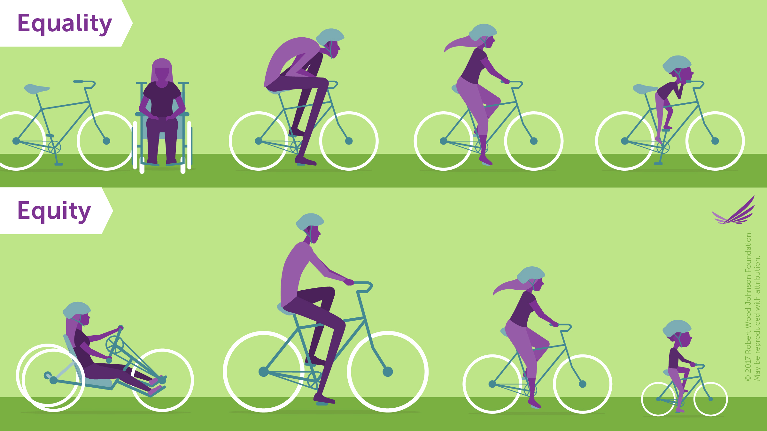
Equity and Equality Video
Notes:
EQUITY and EQUALITY – VIDEO https://youtu.be/MlXZyNtaoDM
STATE: Thank you so much for participating in that activity and conversation. This topic can sometimes be uncomfortable, but it is vitally important if we are truly committed to educating all students.
Let’s look at a video to help us define health equity and health equality.
This short video from the Robert Wood Johnson Foundation provides both definitions and examples, as well as some additional vocabulary that is important as we talk about health equity. Use Handout #1: Key Points and Notes to jot down key elements or learnings for you.
DO: Play YouTube video. If you cannot open it, use:
https://www.youtube.com/watch?v=MlXZyNtaoDM
DEFINING EQUITY and EQUALITY
STATE: How would you describe or define equality and equity?
DO: Allow participants to offer responses.
STATE: Turn to Handout #2. These are commonly used definitions for these terms.
Equity – fairness; every person has the opportunity to “attain his or her full health potential” and no one is “disadvantaged from achieving this potential because of social position or other socially determined circumstances.” (CDC)
Equality – everyone is treated the same, but it may or may not result in equitable outcomes.
STATE: One term not defined in the video is health disparities.
Health disparities are preventable differences in the burden of disease, injury, violence, or opportunities to achieve optimal health that are experienced by socially disadvantaged populations. (CDC)
Look back at the survey questions we just answered. Which question is an example of a health disparity?
DO: Allow a few responses. Question 1 is the correct answer.
STATE: Now that you understand the definitions of these terms, let’s explore these concepts a little more.

Slide 12
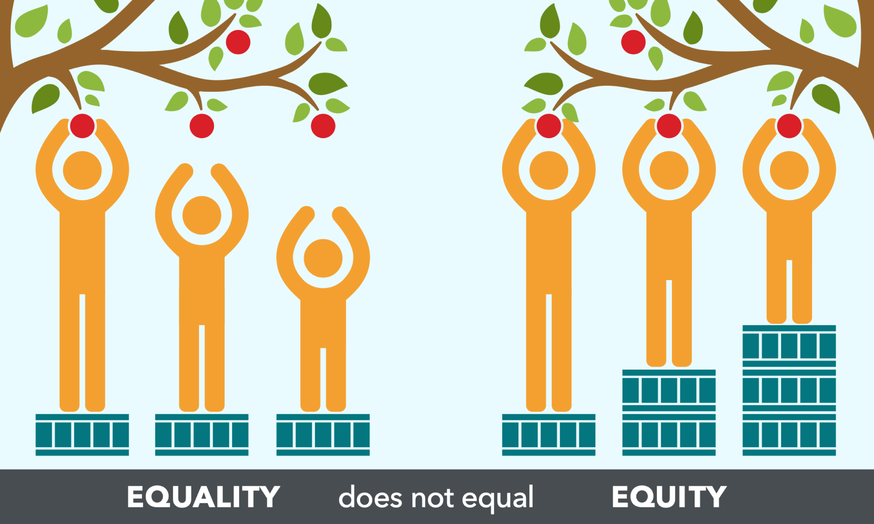
Health Equity and Equality Visual Example
Notes:
HEALTH EQUITY AND EQUALITY VISUAL EXAMPLE
STATE: Let’s look at another visual example.
ASK: What do you see? (all three people have the same size box to pick the fruit.)
ASK: Does it seem fair? Why or why not?
ASK: Is this an example of equality or equity? (equality—everyone is treated the same . . . but it does not result in equitable results. Not all people can pick the fruit.)
ASK: If you don’t think this picture is fair, what could you do about it? (Give the two shorter people taller boxes so they could reach the fruit.)

Slide 13
Health Equity and Equality Visual Example
Notes:
STATE: Yes, one solution would be to give the shorter people taller boxes so they could pick fruit too.
ASK: Is this an example of equality or equity? (Answer: equity, as this is fair; all people have a chance to access or pick the fruit.)

Slide 14
Source: https://healthequity.globalpolicysolutions.org/about-health-equity/
Notes:
HEALTH EQUITY LENS
STATE: As you can see, equality is not the same as equity. Turn to Handout #3: Using a Health Equity Lens. Let’s take what we have learned and apply it to some real-life school health examples.
You will see that we have provided the definitions for all three terms. The examples look at access to feminine hygiene products which, for many girls affects attendance in school and participation in PE and sports.
The health disparity is that some girls—based on where they live or their family’s socioeconomic status—have limited access to feminine hygiene products. This could be for a number of reasons (cost, access to a store, etc.)
A school’s response might be to provide free tampons for all high school girls after establishing a partnership with Tambrands. Wow! At first that looks like a great idea. Providing girls with free tampons will take the worry out of starting their period during the school day, and it will allow more girls to be active during PE. What other benefits could you see by providing free tampons to all girls?
But let’s think about this. What are the problems with this? (Not all girls use tampons.) Why? (religious beliefs, comfort/discomfort, Toxic Shock or other medical reasons, personal feelings, etc.)
So, if we apply the health equity lens, what might we do? (We could provide girls with a choice of feminine hygiene products—because then all girls can benefit from or use the service.)
The equity lens is important. Sometimes we can put a program into place with the best intentions (free tampons), but we might not think about equity and therefore leave some students without the resources they need to be successful.
ACTIVITY
STATE: Now it’s your turn to come up with an example or two. Work as partners or triads to come up with one or two examples. We will share a couple of examples in 10 minutes.
PROCESSING
STATE: Who would like to share an example?
DO: Allow a group or two to share their examples. As they share, be sure to refer back to the definition to ensure the example is authentic.
STATE: Thank you for sharing.

Slide 15
WHY?
Why should schools care about reducing health disparities or addressing health equity?
Notes:
WHY
STATE: Now that you understand the terminology and examples, why should schools care about reducing health disparities in children or addressing health equity, anyway?
DO: Allow participants to respond.
Possible responses:
Healthy students are better learners.
All students deserve a school environment that supports health and wellness.
Healthy students have better attendance, graduation rates.
STATE: There is also a bigger picture. Students who experience chronic disease (asthma, obesity, diabetes) are absent from school more often, have poorer grades, lower graduation rates. As adults, these students tend to have lower paying jobs, higher health care costs, and more illness. So, there is a cycle that education can help address.
While reducing and ultimately eliminating health disparities is a complex undertaking given the social, environmental, and political factors that underlie its existence, education definitely has a role to play.

Slide 16
Every Student Succeeds Act (ESSA)
Federal policy
Supports the whole child, health and wellness
Provides more authority and flexibility to states
Notes:
EVERY STUDENT SUCCEEDS ACT
STATE: A policy that can be leveraged for this work is the Every Student Succeeds Act (ESSA) This federal policy recognizes the need for schools to support the whole child and specifically acknowledges the importance of health and wellness in supporting learning and academic achievement. Under ESSA, states have more authority and flexibility in establishing their plans and strategies. This gives states an opportunity to implement ESSA in a way that supports health and wellness. I encourage you to research the ways that states are using current funding systems to address health equity. Some of the work you find may be replicable in your area.

Slide 17
In Review
Defined health disparities, health equity and health equality
Looked at examples of health disparities, health equity, and health equality and developed our own
Explored why addressing health equity is important for education
Notes:
REVIEW:
STATE: Today we:
1. defined health disparities, health equity, and health equality
2. looked at visual examples of health disparities, health equity, and health equality and developed examples of our own
3. explored why addressing health equity is important for education
We hope you will use this information to improve health equity in your school health and education planning.

Slide 18
Closing Activity
One feeling you had during the module
Two new things that you learned
Three people you are going to share this information with
Notes:
CLOSING ACTIVITY:
STATE: On Handout #4: Closing and Optional Activity, I want you to write down one word for how you felt today, two new things you learned, and the names of three people you will share this information with.
DO: If time allows, have a couple participants share their information.
STATE: Thank you for your participation today and good luck using your equity lens.

Slide 19
Optional Activity
Issues or obstacles your school or community is facing with regard to health equity.
Notes:
NEXT STEPS:
STATE: I’d like each of you to think about an issue or obstacle that your school or community is facing with regard to health equity.
ASK participants to call out the issues—not repeating any that have already been stated.
DO: Capture each idea on a separate flip chart paper and place each up on the wall around the room.
DO: Task the group with brainstorming different ways that schools can begin to tackle these issues that include ALL students. Have participants move freely around the room adding their ideas to as many identified issues as they have ideas.

Slide 20
Optional Activity
What can schools do?
Notes:
STATE: So, what can schools do? From your work, it appears there are steps that schools can take. Feel free to take pictures of these flip charts or make some notes on Handout #1, second page, in the chart provided.
Below are additional ideas of issues or barriers that schools may face. You may want to share some of these if not addressed.
Access to health care—school-based clinics or moving existing clinics to more centrally located places that are accessible by public transportation.
Determine existing barriers.
Staff training on equity.
Include the voices of those most impacted by inequities.
Prioritize the needs of ALL students.
Revise policies or systems that contribute to health disparities.
Redistribute resources (funding, teacher experience, building, out-of-school-time opportunities.
Collaborate with community partners.
Use the WSCC model to focus on every child through the five tenets (healthy, safe, supported, engaged, challenged) using the 10 components.

Slide 21
Thank You!
Trainer Contact Info HERE
Notes:
STATE: Thank you all for your input and work today.
My contact information is listed here should you need it.
Please complete the training evaluation.

Slide 22
References
Braveman, P., Acker, J., Arkin, E., Proctor, D., Gillman, A., McGeary, K.A., & Mallya, G. (2018). Wealth matters for health equity. Robert Wood Johnson Foundation. Retrieved from https://www.rwjf.org/en/library/research/2018/09/wealth-matters-for-health-equity.html?rid=0034400001kzY4bAAE&et_cid=1660865
Centers for Disease Control and Prevention (CDC). (2016). Youth Risk Behavior Surveillance (YRBS) — United States, 2015. Retrieved from https://www.cdc.gov/mmwr/volumes/65/ss/ss6506a1.htm
Centers for Disease Control and Prevention (CDC). (n.d.). Data from 2017 Youth Risk Behavior Surveillance System (YRBSS). Retrieved April 27, 2019 from https://tinyurl.com/y6on53d7
Currie, J. & Lin, W. (2007). Chipping away at health: More on the relationship between income and child health. Health Affairs, 26, 331–344
Egerter, S., Braveman, P., Sadegh-Nobari, T., Grossman-Kahn, R., & Dekker, R. (2011). Education and health. Princeton, NJ: Robert Wood Johnson Foundation
Interaction Institute for Social Change (2016). Illustrating equality vs. equity. Retrieved from https://interactioninstitute.org/illustrating-equality-vs-equity/
Robert Wood Johnson Foundation. (August 6, 2018). Equality vs. equity [Video file]. Retrieved from https://youtu.be/MlXZyNtaoDM
Society for Public Health Education & ASCD, Expert Panel on Reducing Youth Health Disparities. (2010). Reducing youth health disparities requires data for continuous improvement. Retrieved from https://www.sophe.org/wp-content/uploads/2017/01/DatauseYHD_1nov2013_v2.pdf
World Health Organization. (2017). Health promoting school: An effective approach for early action on NCD risk factors. Retrieved from www.who.int/healthpromotion/publications/health-promotion-school/en/
Notes:
References for this training module include the following.

Slide 23
Disclaimer
This project was supported by Cooperative Agreement Number NU38OT000315, funded by the National Center for Chronic Disease Prevention and Health Promotion, Division of Population Health, School Health Branch, from the Centers for Disease Control and Prevention. Contents are solely the responsibility of the authors and do not necessarily represent the official views of the Centers for Disease Control and Prevention or the Department of Health and Human Services.
Notes:
Read disclaimer
Acknowledge the many and varied organizations including school teachers and administrators that helped with the development of the concept and training modules.

